Slide 1

Investigating Happiness
“Happiness is when what you think, what you say, and what you do are in harmony.” —Mahatma Gandhi
Author
Date
GROUP 5
MAY 18, 2023

Slide 2




Meet Group 5
KIRSTEN RAIN
MARK WAANANEN
MIKE WELLNITZ
CRYSTAL ROSENBROOK

Slide 3
Research Questions
1
Which of the World Happiness Report variables have the strongest correlation with happiness?
2
Is there a relationship between the World Happiness Report and Fragile States Index data from 2022?
3
Where are people the most happy based on geography?
4
What are the Top 20 Countries based on Ladder scores over time?

Slide 4
Overview
The World Happiness Report (WHR) 2023 is a comprehensive study that aims to identify the factors that contribute to happiness and well-being around the world. The report is based on data collected from the Gallup World Poll (GWP), which surveys individuals in over 150 countries and asks them to rate their subjective well-being on a scale of 0 to 10. The report uses a variety of statistical techniques to analyze the data, including regression analysis and multilevel modeling, to identify the factors that are most strongly associated with happiness, such as income, social support, and freedom to make life choices.
In addition to the GWP data, the report also includes data from other sources, such as the World Bank, World Health Organization and the United Nations. These data are used to provide context for the happiness scores, and to examine the relationship between happiness and other indicators of well-being, such as health, education, and economic development.

Slide 5
Happiness Score or Subjective Well-Being
(variable name LADDER)
Total WHR Years
In the WHR, the main data source is the GWP. The GWP asks people to rate their life satisfaction on a scale of 0 to 10 using a ladder image, where 10 is the best possible life and 0 is the worst. This rating system is called the Cantril ladder. About 1,000 people in each country respond to the GWP each year. However, the respondents may not be representative of the entire population. Therefore, weights are used to adjust the data and make it more representative of the population as a whole. To get accurate results, the WHR uses a three-year average of these ratings to rank happiness, since more people respond to the GWP over a longer period of time.
11 years
Total GWP Respondents
~1000 per country/year
Top Country (Average)
Finland
Bottom Country (Average)
South Sudan

Slide 6
Six Key Variables
GDP PER CAPITA
HEALTHY LIFE EXPECTANCY
SOCIAL SUPPORT
GDP data from World Development
Indicators except figures for Taiwan, Syria, Palestine, Venezuela, Djibouti and Yemen which are from
the Penn World Table 10.01
Healthy life expectancies at birth are based on data extracted from the World Health Organization’s Global Health Observatory data repository
National average of binary responses to the GWP question
"If you were in trouble, do you have relatives or friends you can count on [or not]?"
FREEDOM
GENEROSITY
CORRUPTION
National average of responses to the GWP question "Are you satisfied or dissatisfied with your freedom to choose what you do with your life?"
Residual of regressing national average of response to the GWP
question "Have you donated money to a charity in the past month?" on GDP per capita
Corruption perception at
the national level is the average response of the overall perception at the individual level captured by two binary GWP questions

Slide 7
Limitations
The data collection and analysis methods used in the WHR are not without limitations. For example, the GWP relies on self-reported data, which may be subject to biases or inaccuracies. Additionally, the survey may not capture the experiences of marginalized or underrepresented populations, such as those living in poverty or experiencing discrimination.
Furthermore, the report's focus on individual-level factors may overlook broader structural and systemic factors that contribute to happiness, such as access to healthcare, education, and employment opportunities. Finally, the report's rankings and findings should be interpreted with caution, as they are based on a subjective measure of happiness that may not fully capture the complexities of human well-being.

Slide 8
WHR Data Analysis Overview
There are 6 variables that we investigated for correlation with the Life Ladder (Happiness) Score: Log GDP per Capita, Social Support, Healthy Life Expectancy at birth, Freedom to Make Life Choices, Generosity, and Perceptions of Corruption.
We were surprised to find there was little correlation between Happiness and Generosity or Perception of Corruption (.17 and -.45 respectively). I did not do a line of best fit for these, because it does not make sense to fit data with no or low correlation to a model/equation. There was a stronger correlation among the remaining factors. The strongest of these was GDP, Life Expectancy and Social Support. ​

Slide 9
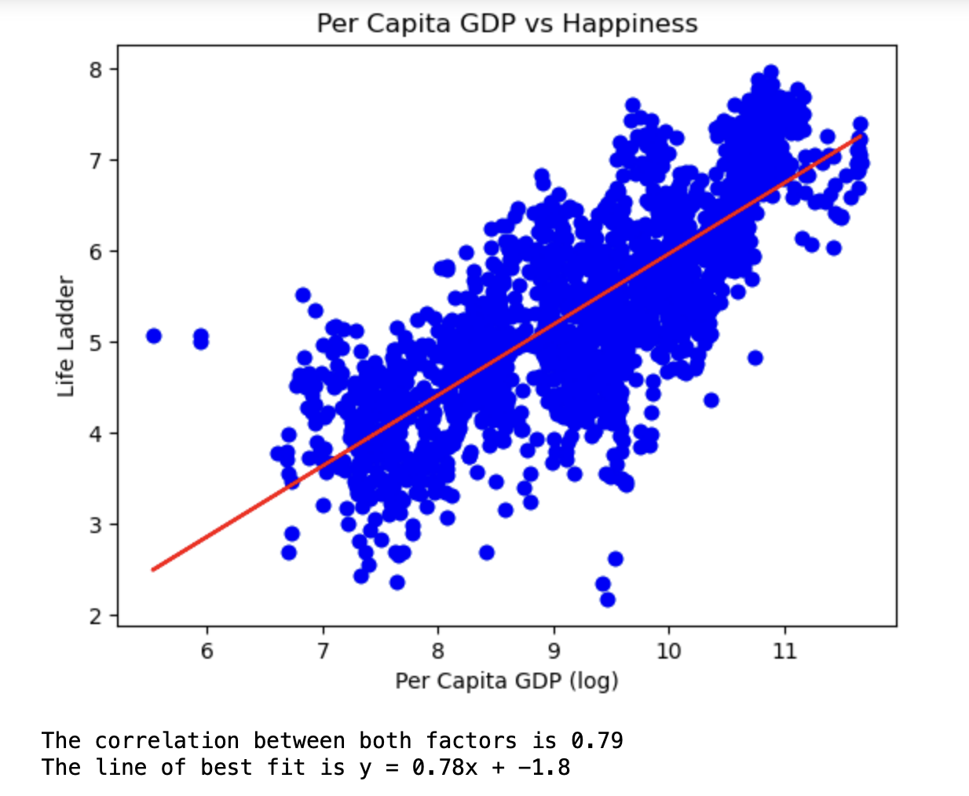
SCATTER PLOT 1
Which of the World Happiness Report variables have the strongest correlation with happiness?

Slide 10
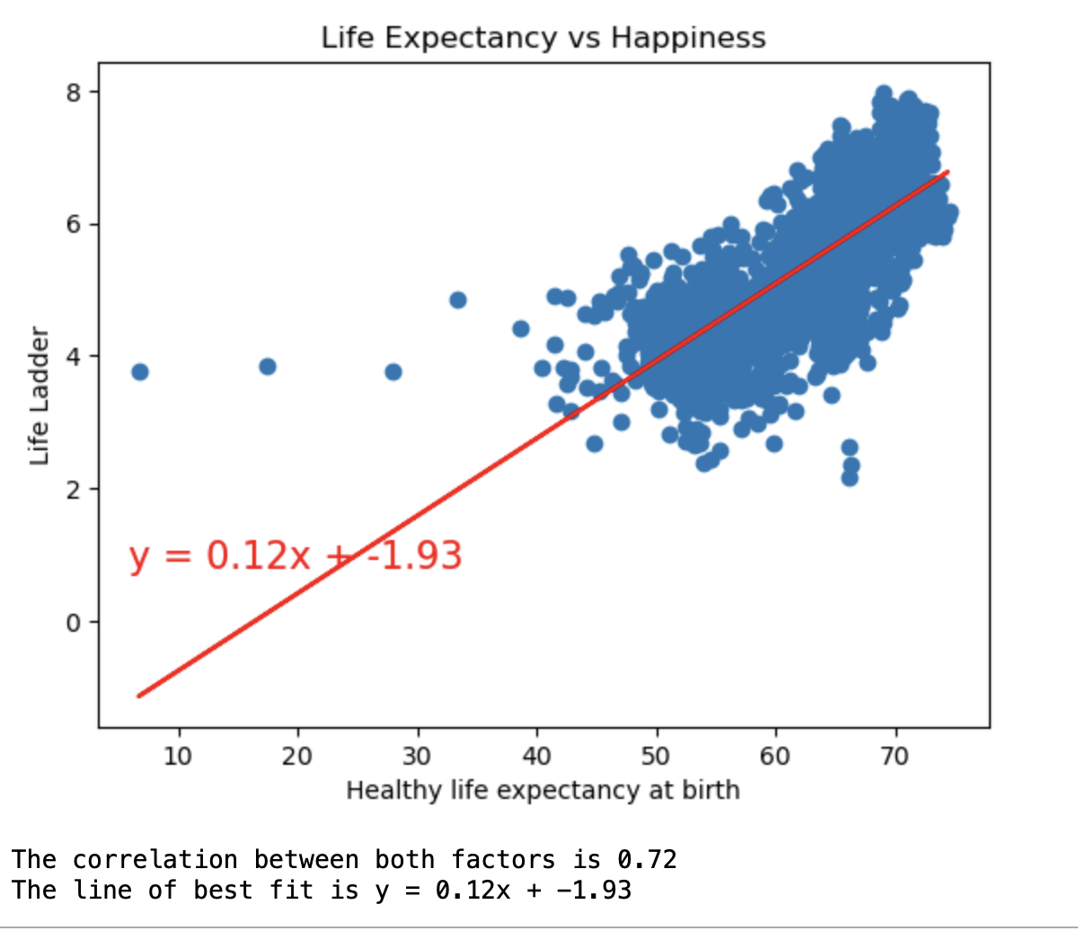
SCATTER PLOT 2
Which of the World Happiness Report variables have the strongest correlation with happiness?

Slide 11
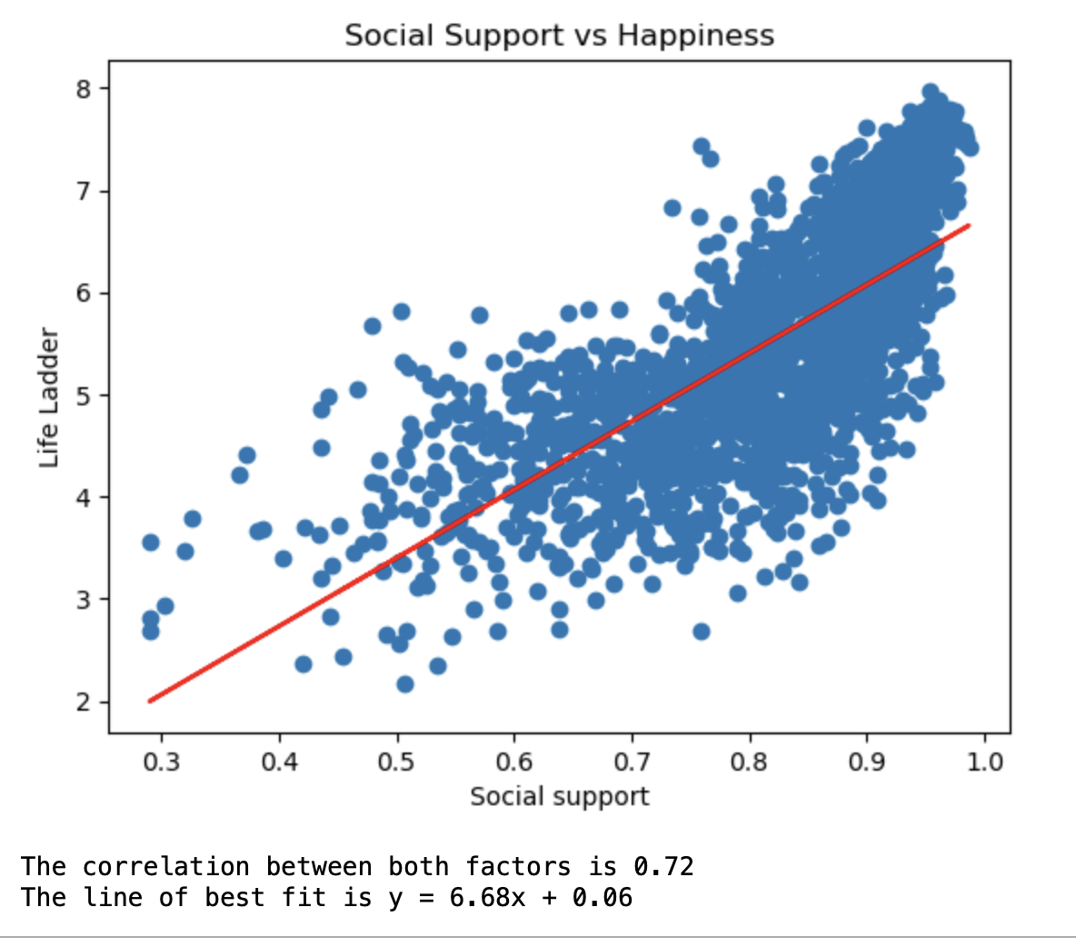
SCATTER PLOT 3
Which of the World Happiness Report variables have the strongest correlation with happiness?

Slide 12
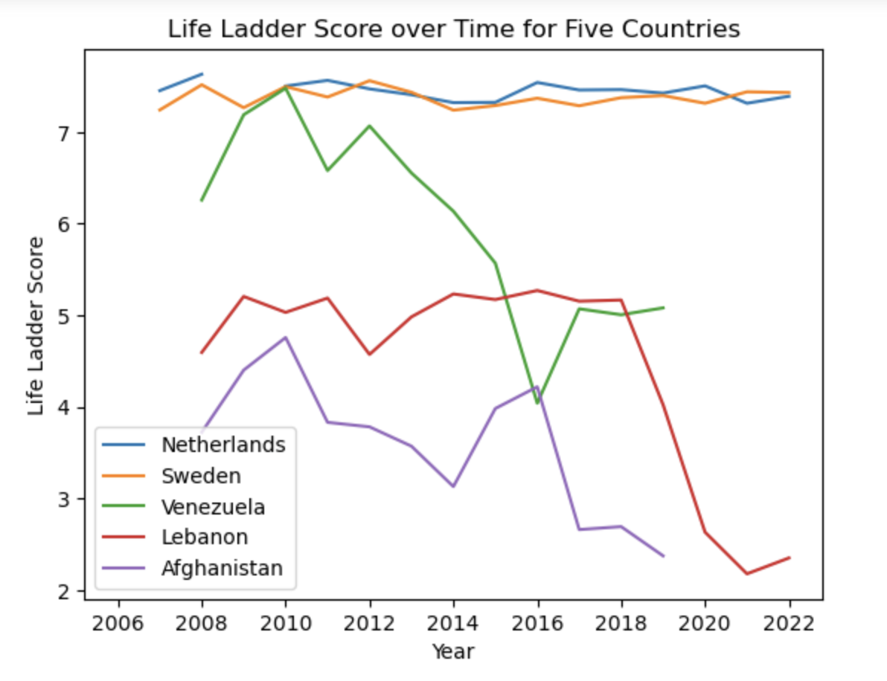
LINE GRAPH
Is there a relationship between the World Happiness Report and Fragile States Index data from 2022?

Slide 13
Fragile States Index (FSI) Overview
The FSI was created in the wake of The Fund for Peace (FFP) Conflict Assessment System Tool (CAST), which was developed to better understand conflict drivers and dynamics. Ultimately the goal of FSI is to measure trends in pressures within each individual state. Indicators with assigned numeric values that contribute to each country’s Total FSI score, include:
Security Apparatus, Fractionalized Elites, Group Grievance, Economic Decline, Uneven Development, Human Flight/Brain Drain, State Legitimacy, Public Services, Human Rights, Demographic Pressures, Refugee IDPs, External Intervention

Slide 14
FSI Data Analysis Overview
Realizing that these countries with a lot of variability in their happiness score also had a lot of instability in their country led us to investigate if there was a way to measure that. We found that info on the Fragile States Index. There is a strong relationship between countries based on listed recorded scores in WHR vs FSI. Highly ranked countries on the WHR scored lowly in the FSI, and vice versa. The correlation between both factors, the WHR Ladder score and the FSI Total score, is -0.82. This can be seen by related scatter plot and linear regression.

Slide 15
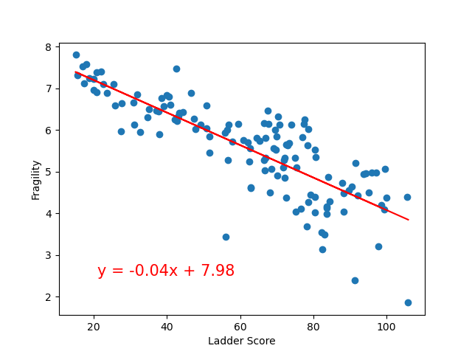
SCATTER PLOT
Is there a relationship between the World Happiness Report and Fragile States Index data from 2022?

Slide 16
Geographic Data Analysis Overview
The following maps illustrate where people are the most happy and also the fragility of many of those countries. “Happiness” appears to be most prevalent in European nations, many of which also have a low Fragility score. Higher Fragility scores exist throughout African nations and many Middle Eastern countries.

Slide 17
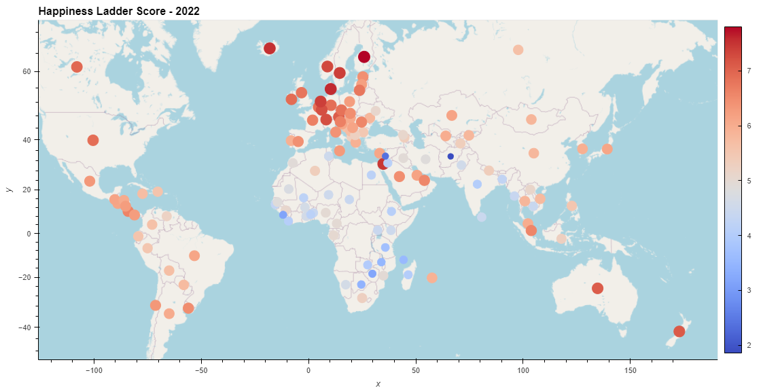
HAPPINESS MAP
Where are people the most happy based on geography?
Ladder Score

Slide 18
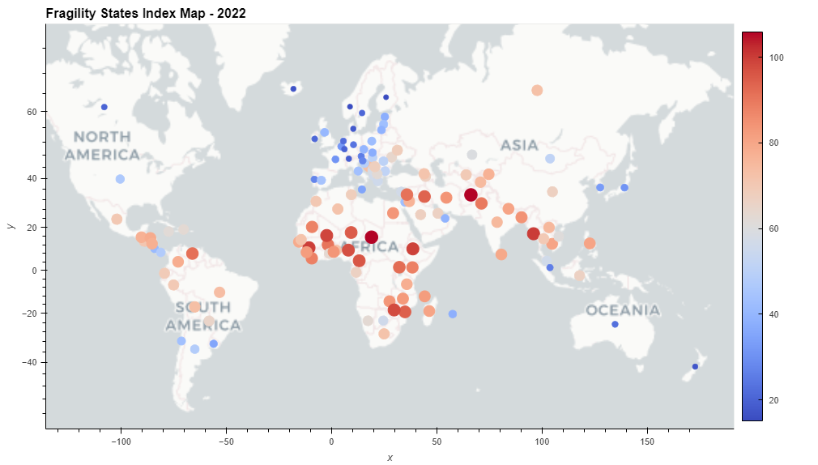
FRAGILITY MAP
Where are people the most happy based on geography?
Fragile States Index

Slide 19
Top 20 Countries Data Analysis Overview
The following line graph and heatmap illustrate the top 20 countries over time. The line graph indicates that the Ladder scores have been consistently high for certain countries such as Finland, Denmark, and Switzerland, while others such as Greece and Italy have shown more variation. Overall, there seems to be a slight upward trend in Ladder scores for most countries in the top 20, with some countries showing more significant increases over time. The heatmap reveals that most of the top 20 countries have had an increase in their life ladder score over time, with a few exceptions. It also shows that the life ladder scores for most countries tend to be higher in the more recent years, similarly suggesting an overall improvement in subjective well-being over time.

Slide 20
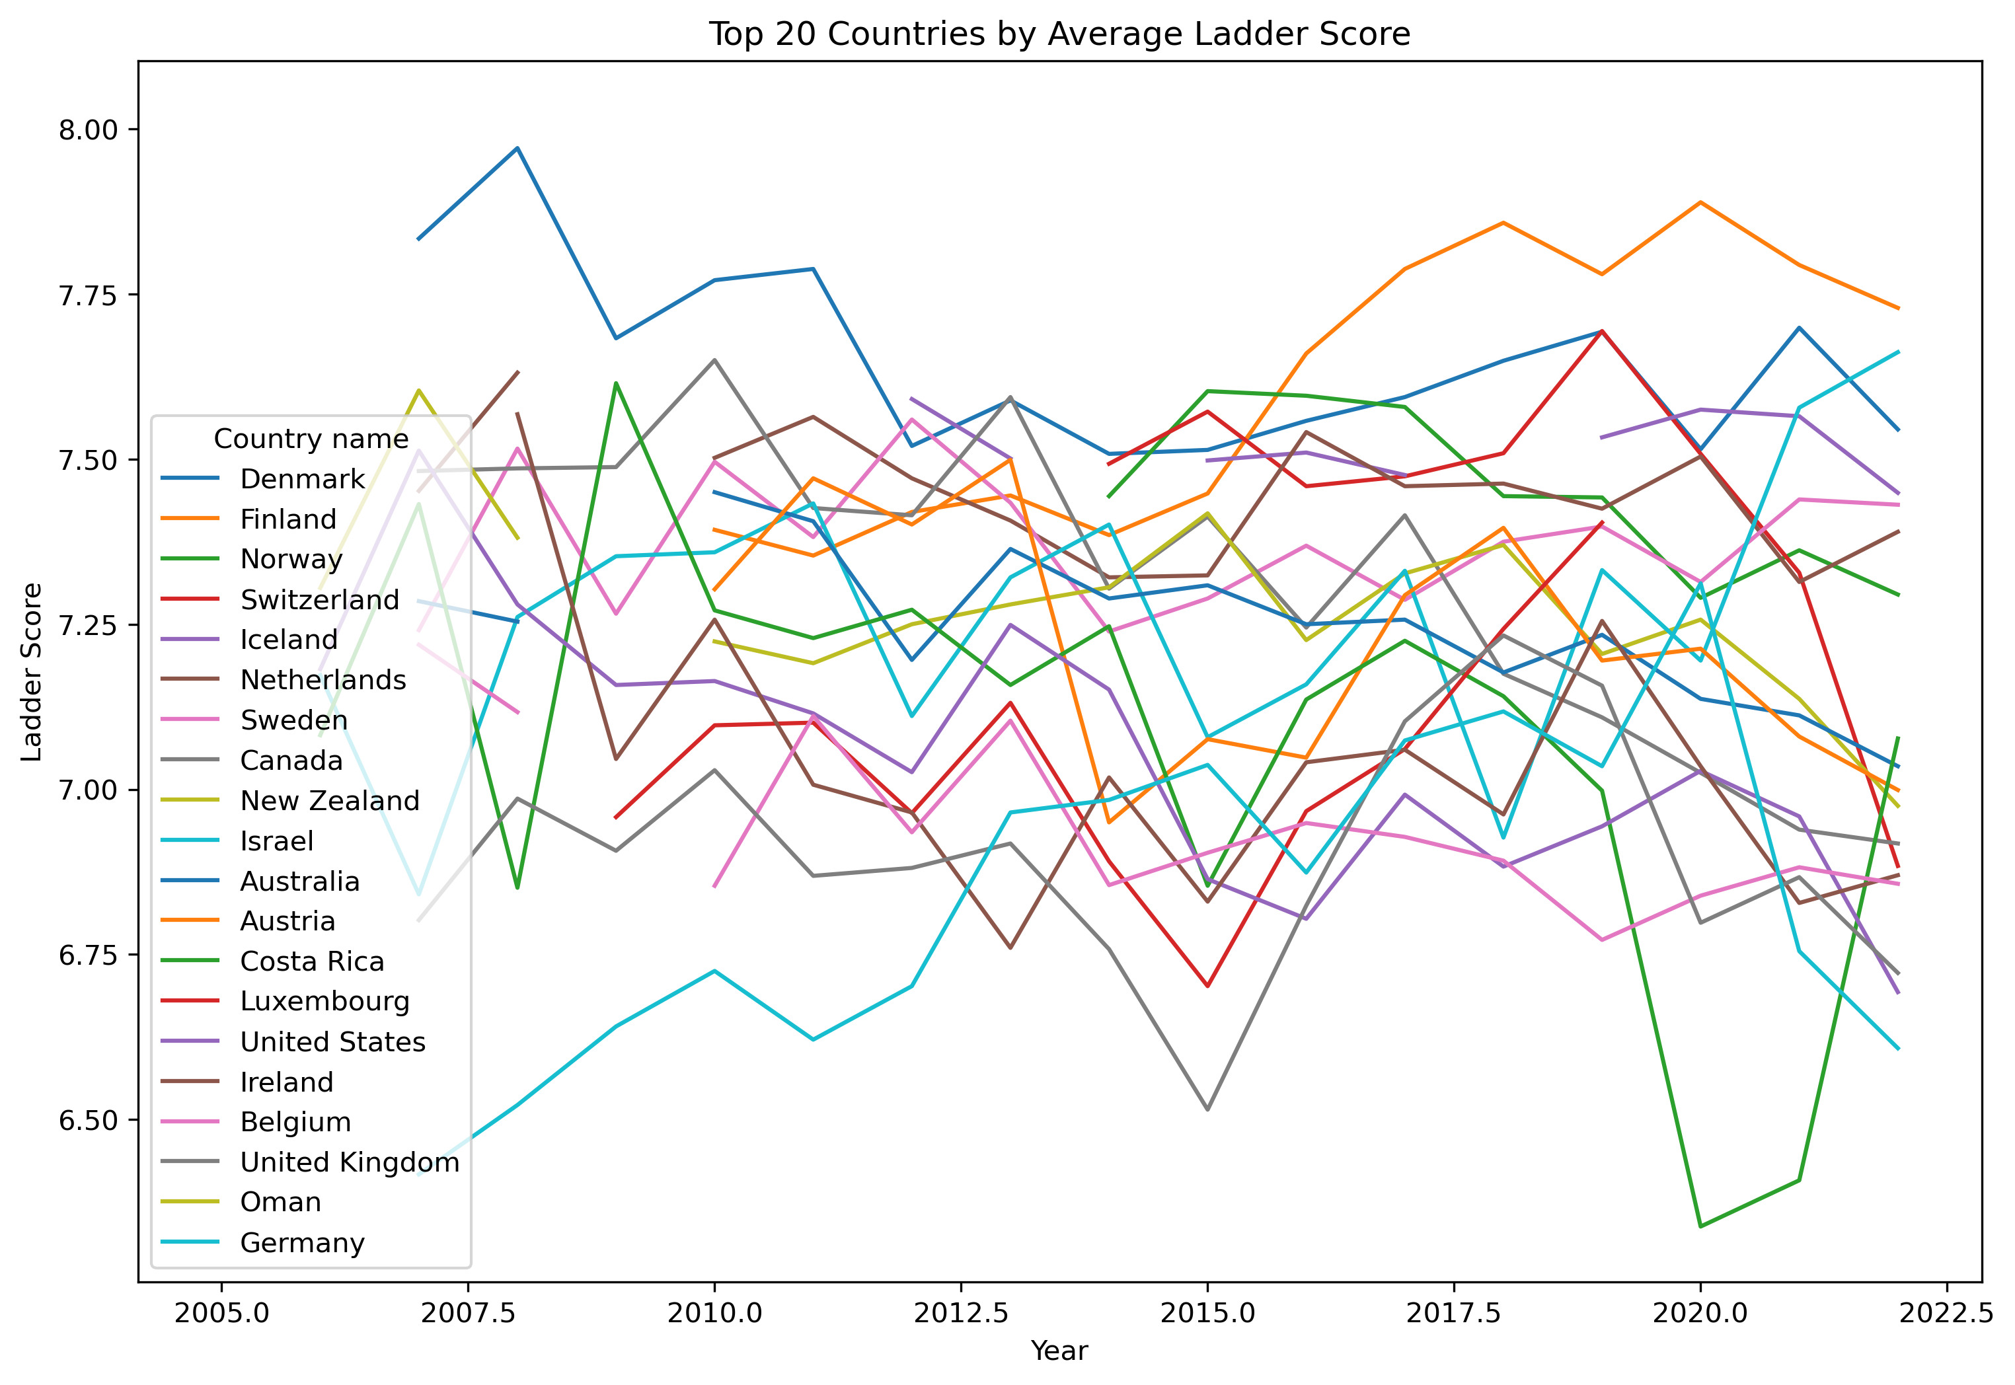
LINE GRAPH
What are the Top 20 Countries based on Ladder scores over time?

Slide 21
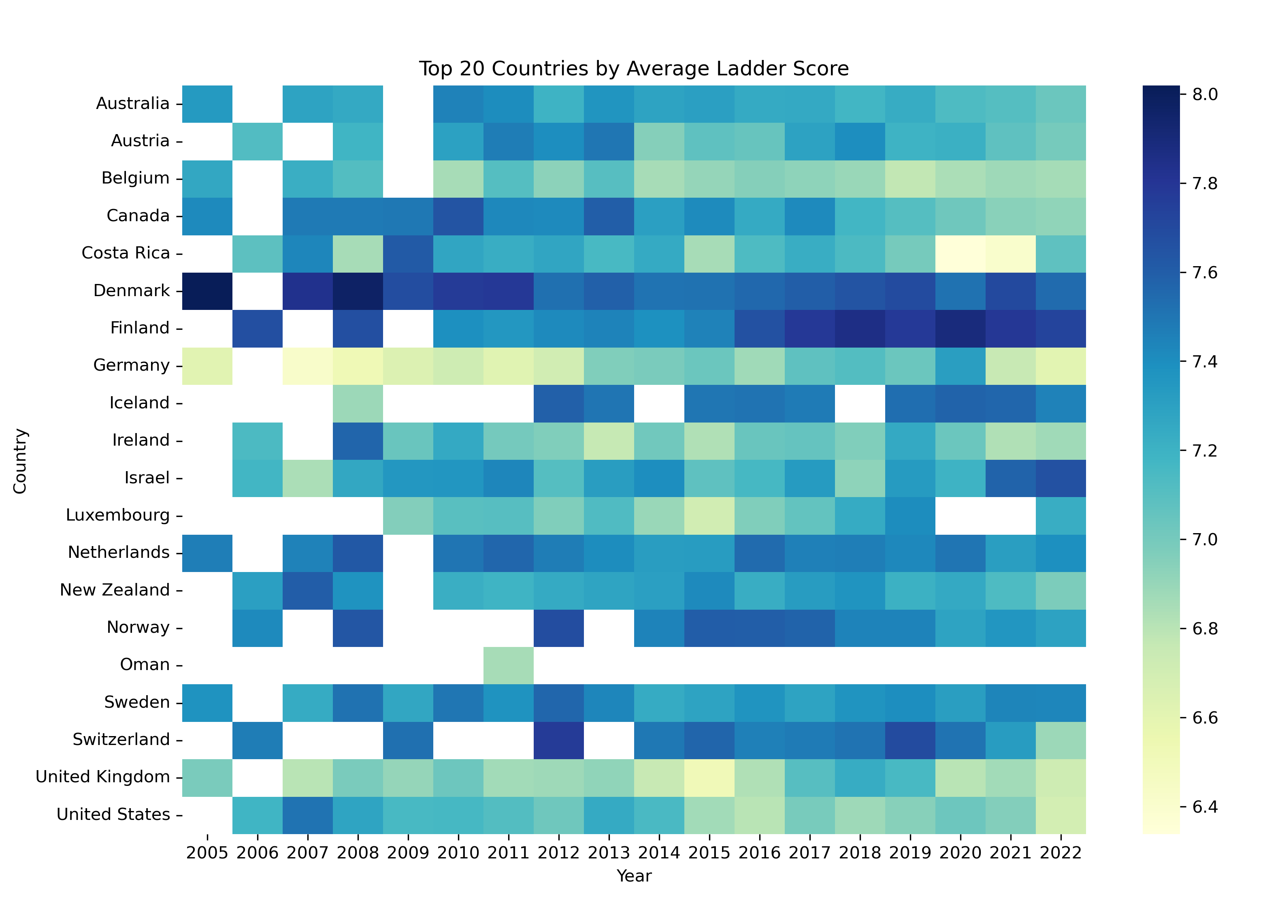
HEATMAP
What are the Top 20 Countries based on Ladder scores over time?

Slide 22
THANK YOU FOR YOUR ATTENTION
WE ARE HAPPY TO TAKE YOUR QUESTIONS :)​
“Now and then it's good to pause in our pursuit of happiness and just be happy.”
―Guillaume Apollinaire

